Slide 1
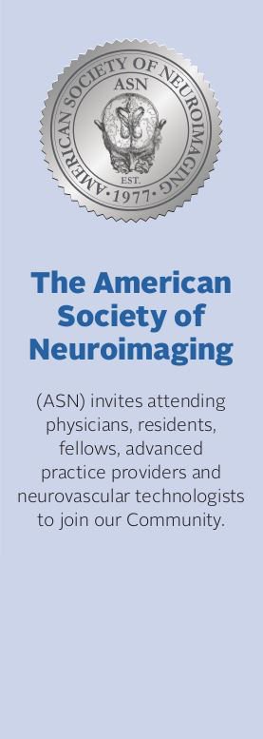
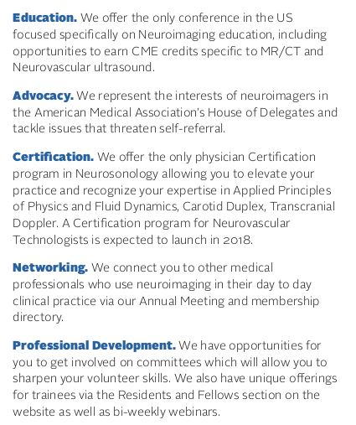
AAN attendees receive a 10% discount on membership when you join before Saturday, April 29!
Join at www.asnweb.org and enter in code AANASN

Slide 2
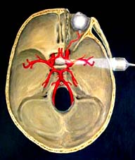
Neurosonology Exam Certification in Physics, Transcranial Doppler and Carotid Duplex
February, 7, 2018 – Austin, Texas
Exam Registration Opens: November 1, 2017
Registration Deadline: December 18, 2017
Visit www.asnweb.org for eligibility requirements

Slide 3
